Slide 1
Tattoo parlor location
Battle of the neighborhoods: Toronto, San Francisco and New York
By: Kudakwashe Mawunganidze

Slide 2

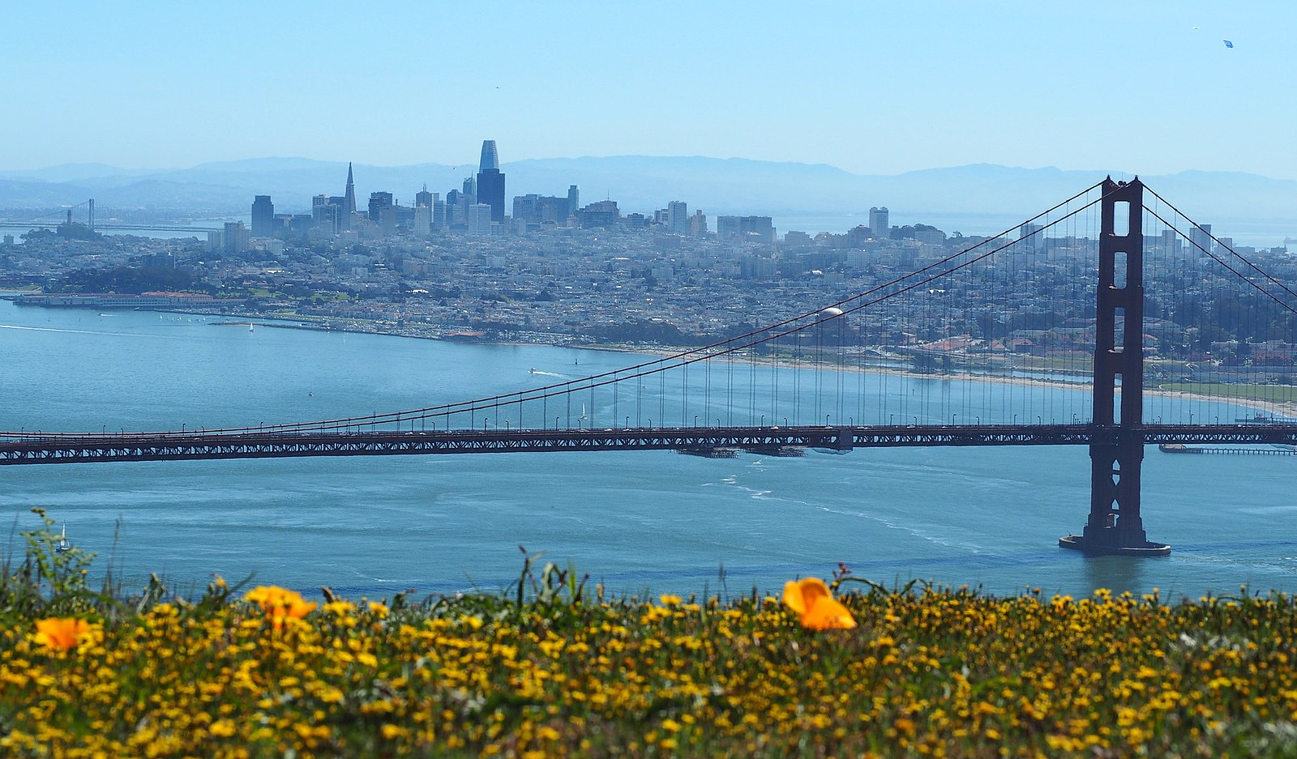

Business problem
Graduating friends are deciding where to set up their first tattoo parlor.
They each hail from one of the cities TO, NY, SF.
Their initial main concern is competition.

Slide 3

Data
Foursquare API was the main data source
Crime data was also used. Why?
Halfway through the project, the artists decided to rule out Toronto, and just focus on SF and NYC. As a result, they added a new factor to the analysis i.e. crime data.

Slide 4
Output/results
Results for analysis were shown in tables and maps.
Tables were used to show the rates of crime in different neighborhoods in NY and SF.
Maps were used to show the distribution of tattoo parlors in the cities

Slide 5
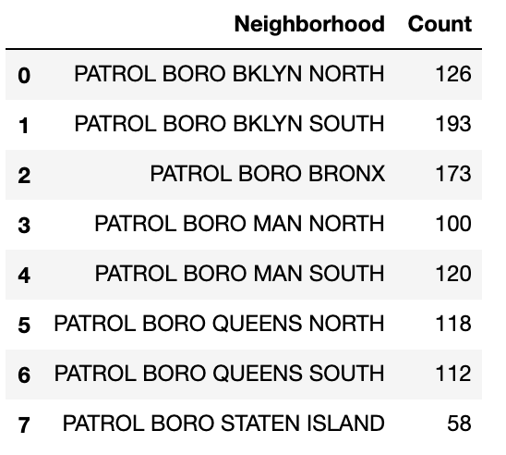
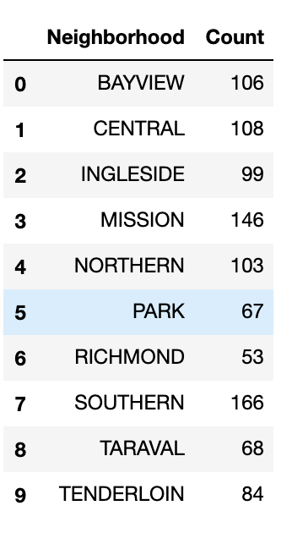

Crime findings
New York Neighborhoods (above)- Brooklyn South had the highest crime incidence
San Francisco Neighborhoods (left)- Southern has the highest incidence of crime.

Slide 6
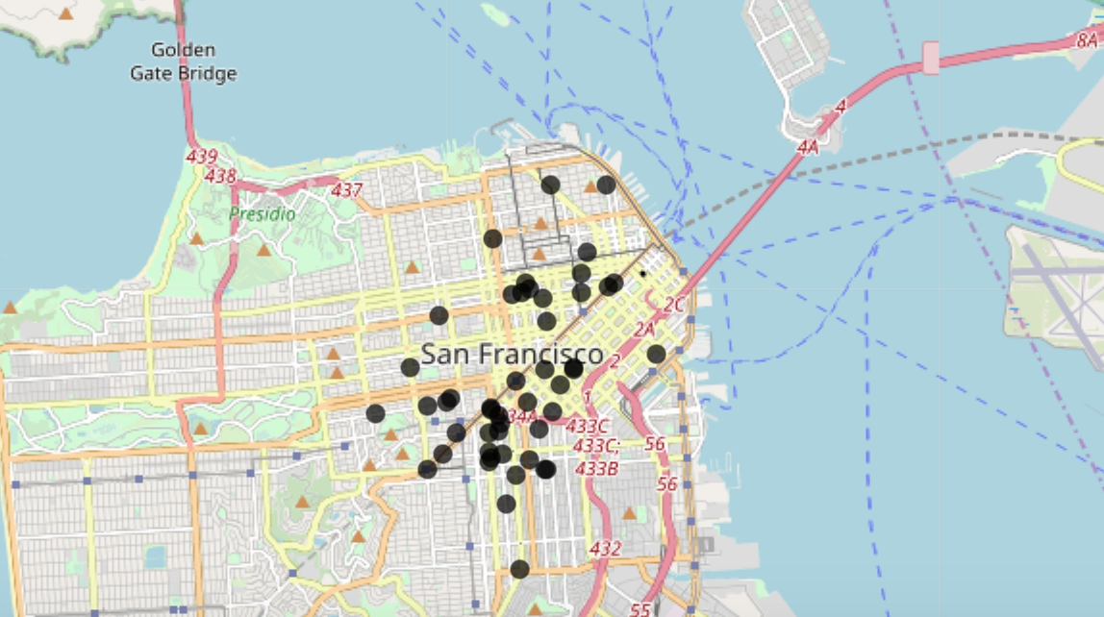
Tattoo parlor distribution: SF
The black dots indicate the locations of tattoo parlors in San Francisco.

Slide 7
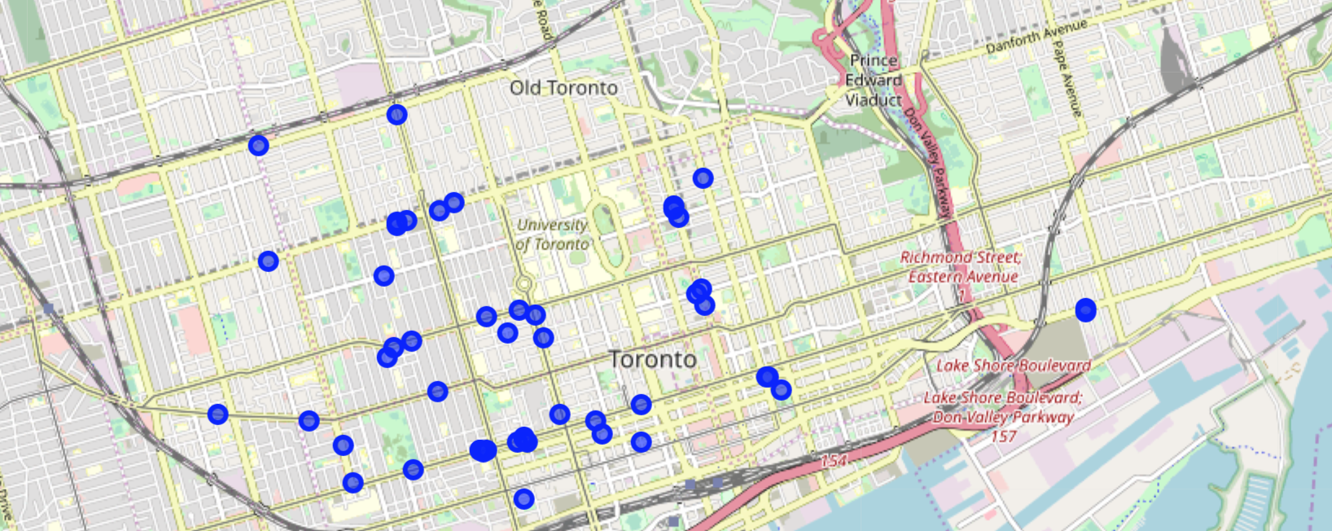
Tattoo parlor distribution: to
The blue dots show the distribution of tattoo parlors in Toronto

Slide 8
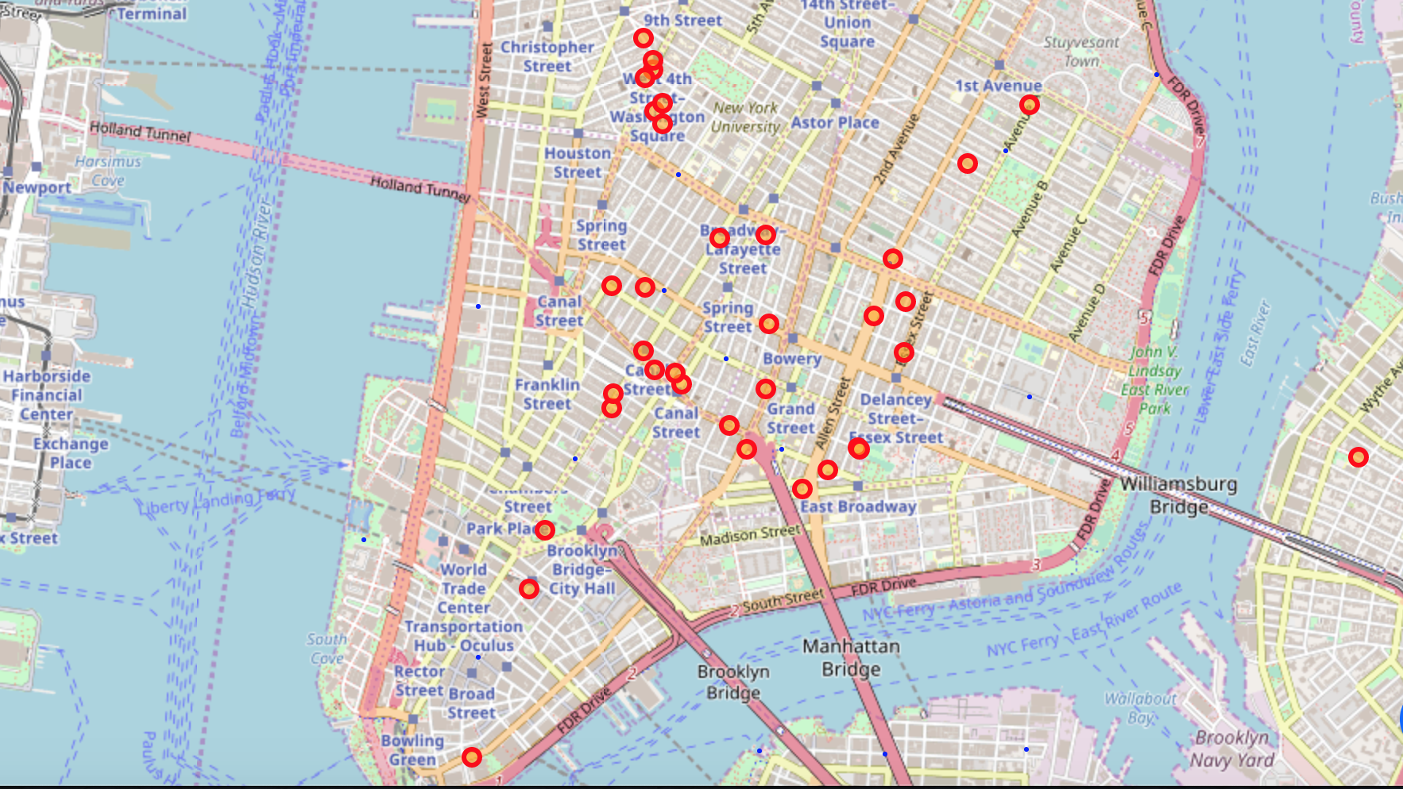
Tattoo parlor Distribution: nyc
The red and yellow dots show the location of tattoo parlors in NYC

Slide 9
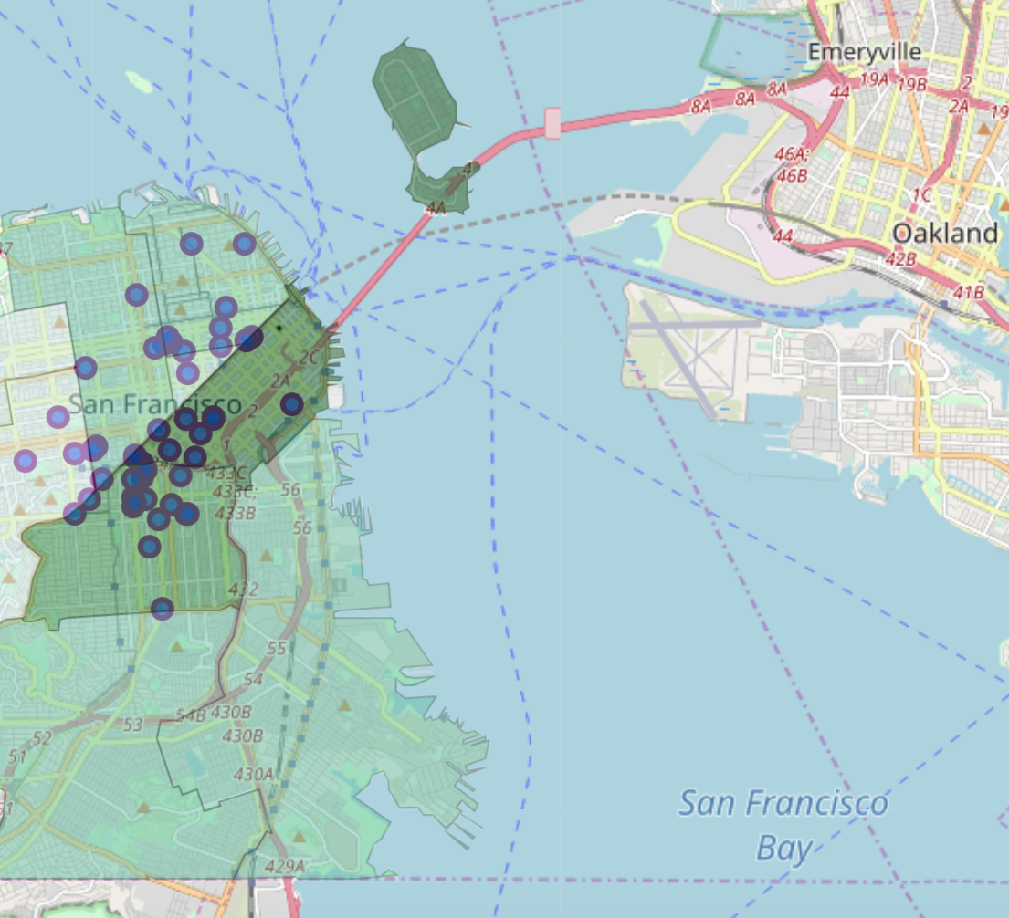
Distribution and crime: San Francisco
The dark green areas show high crime incidence. The lighter green shows lower crime incidence. From this map, our artists can have a rough idea of places to set up their business if they are worried about crime incidence.

Slide 10
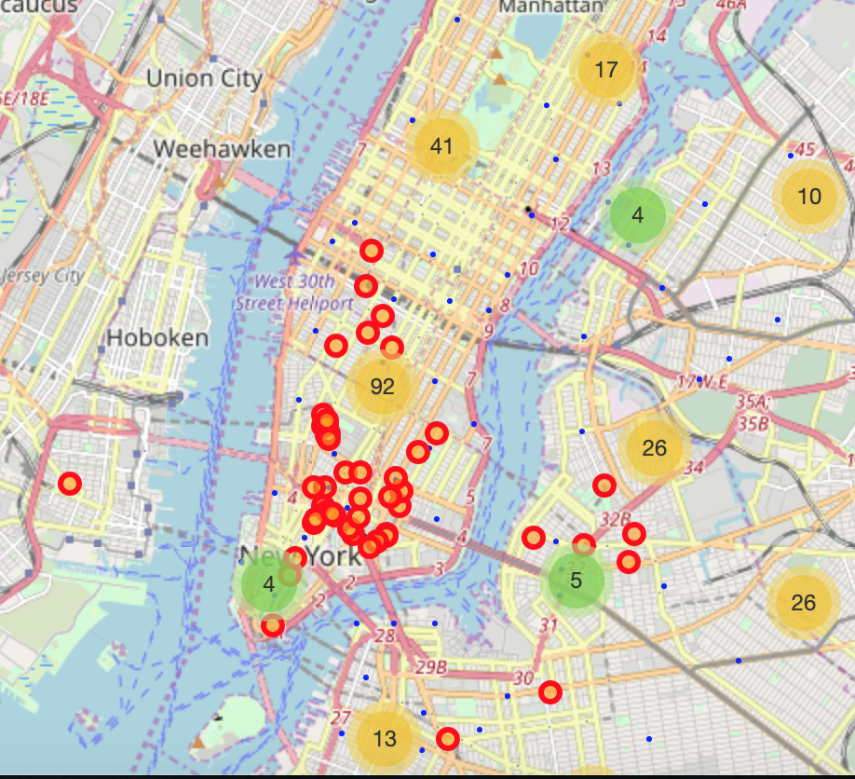
Distribution and Crime: nyc
The numbers in the bigger circles show the incidence of crime in the different areas. The red and yellow dots indicate the location of the tattoo parlors.

Slide 11
Recommendations
New York City: Most places other than the Manhattan Island for competitiveness, and Staten Island for both reduced competitiveness and reduced crime incidence.
San Francisco: Port, Bayview and Ingleside neighborhoods are the best places to set up shop.

